Slide 1
High-Density Lipoprotein Project
Huaiyu Zang
Joint work with Dr. Jason Lu

Slide 2
Background
HDL(High density Lipoproteins) are blood-borne complexes composed of lipids and proteins that play critical roles in the prevention of cardiovascular disease
HDL particles are able to remove cholesterol from within artery atheroma and transport it back to the liver for excretion or re-utilization, which is the main reason why the cholesterol carried within HDL particles (HDL-C) is sometimes called “good cholesterol”
Those with higher levels of HDL-C seem to have fewer problems with cardiovascular diseases, while those with low HDL-C cholesterol levels have increased rates for heart disease

Slide 3
Background
However, recent clinical trials of therapeutics show that only raising HDL cholesterol levels failed to confer the expected CVD protections.
People have consensus that measurement of one minor HDL component is not sufficient to capture the cardio-protective potential of HDL
The staggering complexity of HDL demands significantly more investigation before we can truly understand HDL metabolism and function in humans.

Slide 4
HDL subspecies
Recent evidence show that some HDL subspecies will maintain stable compositions, likely to carry out distinct functions
We draw our attention from HDL_C to HDL Protein and think of “HDL” as a set of protein assemblies that could perform complex biological functions
If we can characterize the structural composition and functionality of HDL subspecies, it may be most advantageous to pharmacologically raise only certain sub-particles to achieve benefits and enhance HDL functions.

Slide 5
HDL subspecies
Lipid associated proteins with similar co-migration patterns when separated by different techniques are likely to form distinct lipoprotein subspecies.
Design an experiment to investigate co-migration pattern

Slide 6
Three orthogonal separation chromatography technique
Gel Filtration (GF) chromatography
Separating particles by size
Applied to three normal plasma, separating 17 fractions and identifying 106 HDL associated proteins.
Anion Exchange (AE) chromatography
Separating particles by charge
Applied to four normal plasma, separating 21 or 24 fractions and identifying140 HDL associated proteins.
Isoelectric focusing (IEF) chromatography
Separating particles by isoelectric point
Applied to three normal plasma, separating 20 fractions and identifying 93 HDL associated proteins.
HDL associated proteins & abundance profiles were determined by Mass Spectrometry (MS).

Slide 7
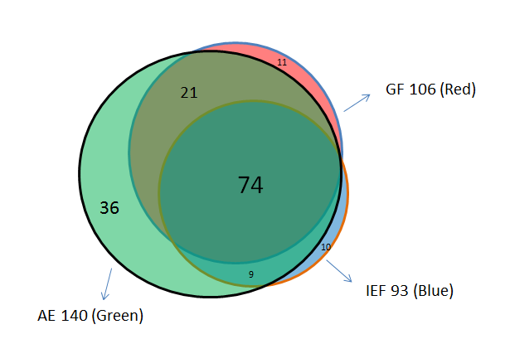
The Venn diagram of the identified HDL associated proteins from three method
Venn Diagram of Proteins in three experiments
There are 161 unique HDL associated proteins across all three techniques and 74 are overlapping proteins identified among three analyses

Slide 8
Protein composition
Identifying the protein composition of particles contained in the various fractions by MS data analysis.
Providing a semi-quantitative abundance readout across the fractions.

Slide 9
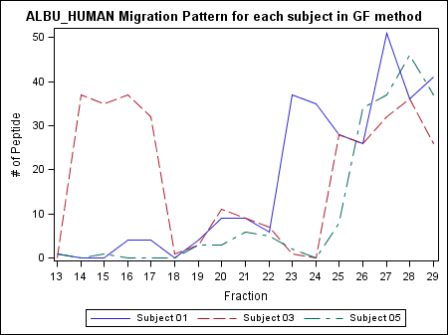
ALBU_Human(GF)
X axis refers to fraction numbers and Y axis refers to peptide counts

Slide 10
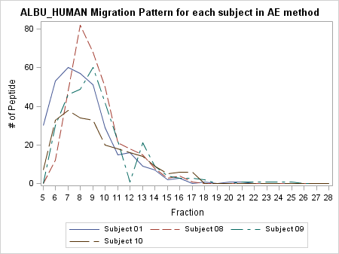
ALBU_Human (AE)
X axis refers to fraction numbers and Y axis refers to peptide counts

Slide 11
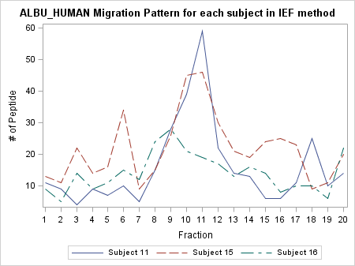
ALBU_Human(IEF)
X axis refers to fraction numbers and Y axis refers to peptide counts

Slide 12
Summary of the graphs
From three graphs, we can see that HDL protein tend to have similar migration pattern for each subject and separation method.
Consistent with our intuition.

Slide 13
Variation between subjects
Paired T –test: DF t Value Pr > |t|
2210 -7.43 <.0001

Slide 14
Preliminary data observation
0 peptide:
AE(01): PCYOX, ZA2G
AE(08):KLKB1, PXYOX
AE(09): KLKB1, PCYOX
AE(10): APOF, CIS, LUM,SAMP
GF(01): APOC2
GF(03): A1BG, A2AP, AFAM, APOC2, APOL1,HBB, HPTR, TRFE
GF(05): AFAM, HBB, TREF
IEF(11): APOD, C1S, LBP, LUM
IEF(16): A1AG1, APOD, HPTR
Note: Red indicates the maximum # of peptide in each subject less than 2.

Slide 15
Quantify the similarity of protein co-migration patterns
Assuming that those proteins had similar co-migration patterns may involve in the same sub-particles.
Using nonparametric Spearman’s rank correlation coefficient to quantitatively measure the similarity of co-patterns between proteins.
For each pair of protein in one separation technique, calculating one correlation of this pair; each pair of protein has three correlation coefficients.

Slide 16
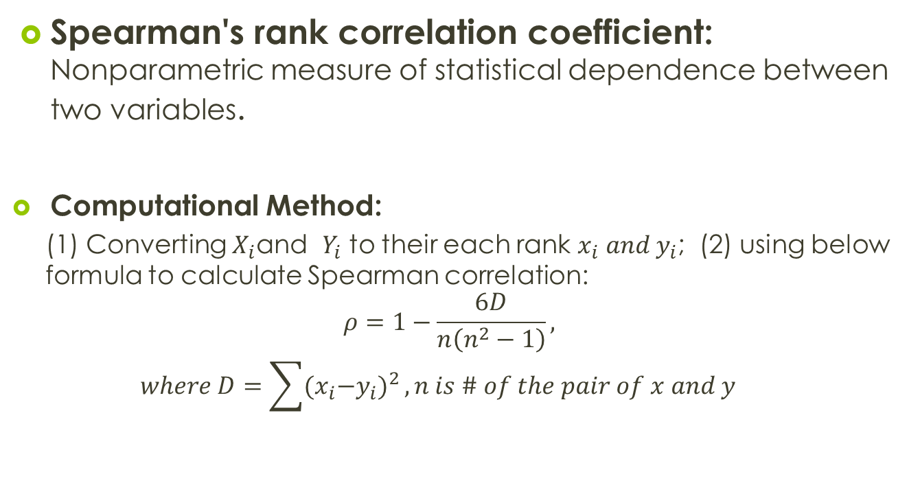
Spearman’s Rho
Spearman's rank correlation coefficient: Nonparametric measure of statistical dependence between two variables.
Computational Method:
(1) Converting $X_{i}$and $Y_{i}$ to their each rank $x_{i} and y_{i}$; (2) using below formula to calculate Spearman correlation:
$$ρ=1−\frac{6D}{n\left(n^{2}−1\right)},$$
$$where D=\sum{{{(x}_{i}−y_{i})}^{2}}, n is \# of the pair of x and y$$

Slide 17
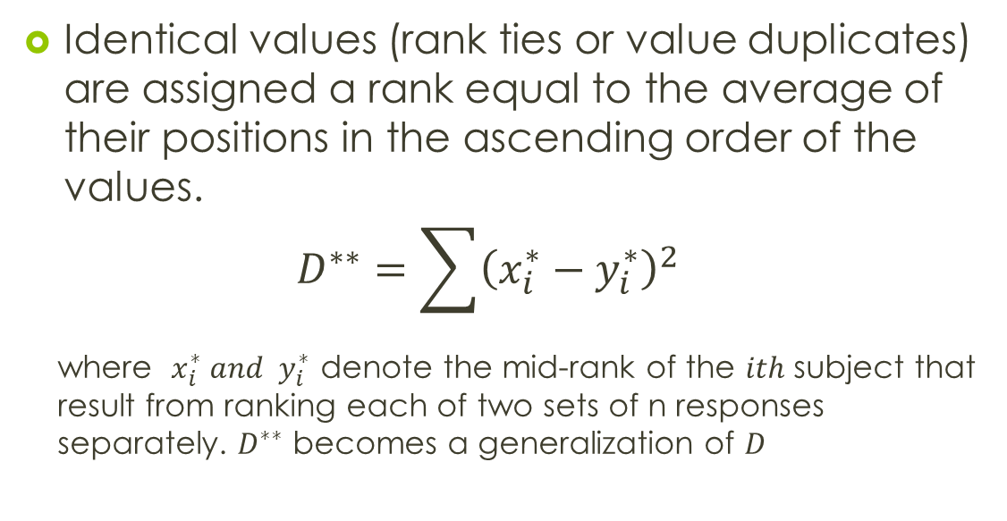
Ties
Identical values (rank ties or value duplicates) are assigned a rank equal to the average of their positions in the ascending order of the values.
$$D^{∗∗}=\sum{{\left(x_{i}^{∗}−y_{i}^{∗}\right)}^{2}}$$
where $x_{i}^{∗} and y_{i}^{∗}$denote the mid-rank of the $ith$ subject that result from ranking each of two sets of n responses separately. $D^{∗∗}$ becomes a generalization of $D$

Slide 18
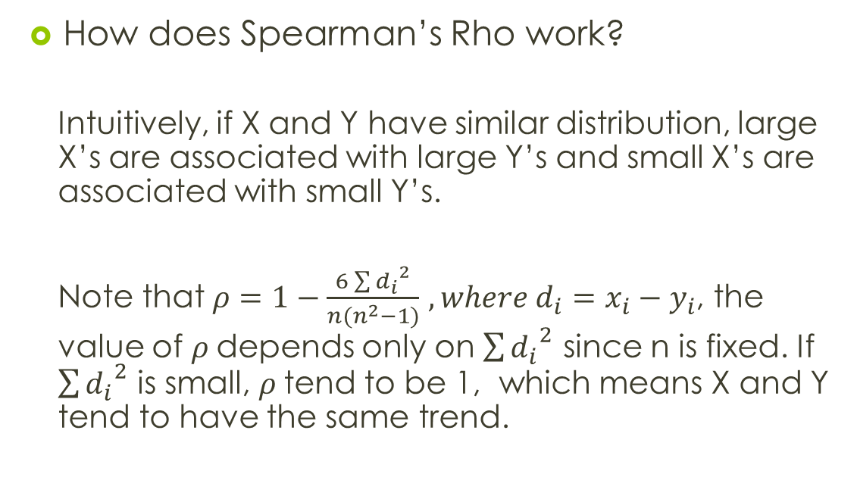
Spearman’s Rho
How does Spearman’s Rho work?
Intuitively, if X and Y have similar distribution, large X’s are associated with large Y’s and small X’s are associated with small Y’s.
Note that $ρ=1−\frac{6\sum{{d_{i}}^{2}}}{n(n^{2}−1)}$ $, where d_{i}=x_{i}−y_{i}$, the value of $ρ$depends only on $\sum{{d_{i}}^{2}}$ since n is fixed. If $\sum{{d_{i}}^{2}}$ is small, $ρ$tend to be 1, which means X and Y tend to have the same trend.

Slide 19
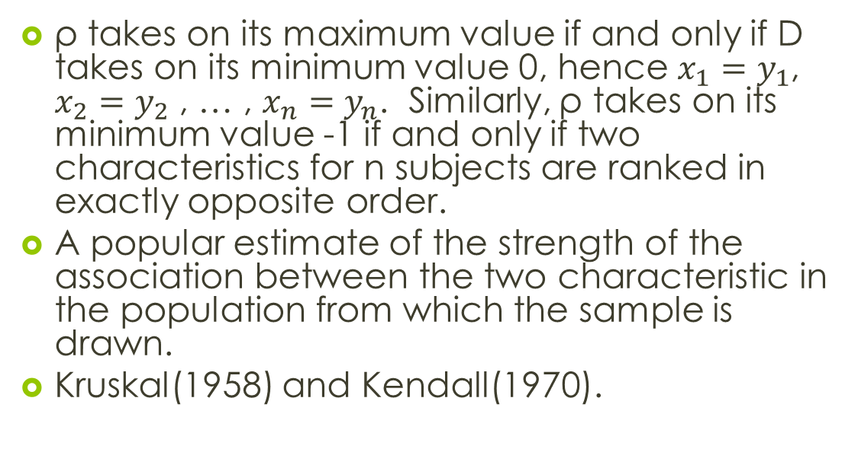
Spearman’s Rho
ρ takes on its maximum value if and only if D takes on its minimum value 0, hence $x_{1}=y_{1}$, $x_{2}=y_{2}$ , … , $x_{n}=y_{n}$. Similarly, ρ takes on its minimum value -1 if and only if two characteristics for n subjects are ranked in exactly opposite order.
A popular estimate of the strength of the association between the two characteristic in the population from which the sample is drawn.
Kruskal(1958) and Kendall(1970).

Slide 20
Spearman’s Rho
Advantages:
X and Y values can be continuous or ordinal, and distribution assumption not required (our data is count data).
Easy to interpret: 0.8<ρ< 1 means positive association or 0<ρ<0.3 means no association

Slide 21
Calculating ρ
Spreading out the protein pair fractions of all subjects in each method.
Having 93(21+24+24+24) fractions in AE, 51(17+17+17) fractions in GF, 60 (20+20+20)fractions in IEF.
Calculating ρ based on these spread-out protein pair peptide in all subjects in fraction.

Slide 22
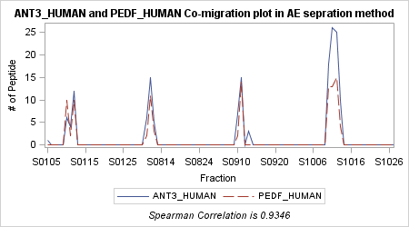
Some example(AE)

Slide 23
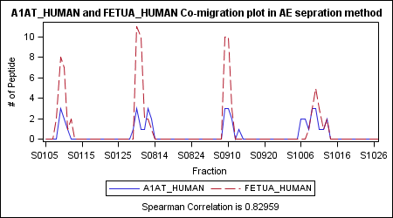
Some example(AE)

Slide 24
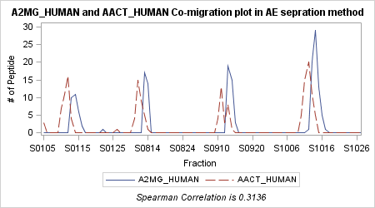
Some example(AE)

Slide 25
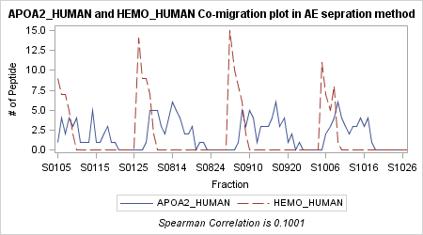
Some example(AE)

Slide 26
Co-migration “score”
Designing an integral co-migration “score” containing co-migration pattern information in three experiments based on the correlation of protein pair.

Slide 27
Score calculation
When Nummissing=0 (correlation occurs in all three method):
If min(AE,GF, IEF) > 0.7, then Score=max(AE,GF,IEF)*2;
else if median(AE,GF,IEF)>0.7, then Score=max(AE,GF,IEF)*1.5;
else Score=max(AE,GF,IEF).
When Nummissing=1(correlation occurs in two method):
If min(AE, GF, IEF)>0.7, then Score=max(AE,GF,IEF)*1.5; else Score=max(AE, GF, IEF).
When Nummissing=2(correlation occurs only in one method):
Score=max(AE, GF, IEF).

Slide 28
Co-migration “score”
How does the Co-migration “score” work？
Intuitively we have more confidence if high correlation occurs in all three separation methods.
For the correlations of each pair greater than 0.7, we have a strong evidence that this pair has a similar co-migration pattern and can give more “weight” to calculate the final score.

Slide 29
Literature support
Co-migration pattern is an experiment support and one of the features we could use to predict “Sub-particle”.
The prediction also needs literature support such as GO, mRNA expression correlation, and Co-essentiality.

Slide 30
Future Plan
Experiment
Classifier
Prediction
Literature
Validation
mRNA co-expression
GO function
Co-evolution

